Slide 1
AGM Rules
1. Please be respectful (disrespectful comments, remarks or gestures will not be tolerated)
2. Please mute your volume, the moderator will unmute you if you have a question or are presenting
3. Please turn your video off unless you are asking a question or presenting.
4. If you have a question or comment – please use the chat function (found at the bottom of your screen) or raise your virtual hand (this can be found if you click on participants and you can see under the names there is a blue hand to raise your virtual hand). One of the Board members will be monitoring for activity.
5. When asking your question, you will be limited to a 2 minute time frame to keep the meeting moving forward (additional time can be provided if follow-up discussion warrants it)
6. After the moderator has unmuted you, please speak clearly when are presenting, asking a question or commenting
7. When a vote is required, we will use the poll function. Every email address registered will be entitled to one vote per poll.

Slide 2
Deer Valley Annual General Meeting
November 19, 2020

Slide 3
Introduction
David Frey - Chair
Kristen Abel - Secretary
Jennifer Klatt – Member

Slide 4
2019/20 Activities
Playground Upgrades complete, landscaping started
Microsurfacing to roadways in Deer Valley – extending usable life by 10-12 years
Deer Valley Community Standards Bylaw passed

Slide 5
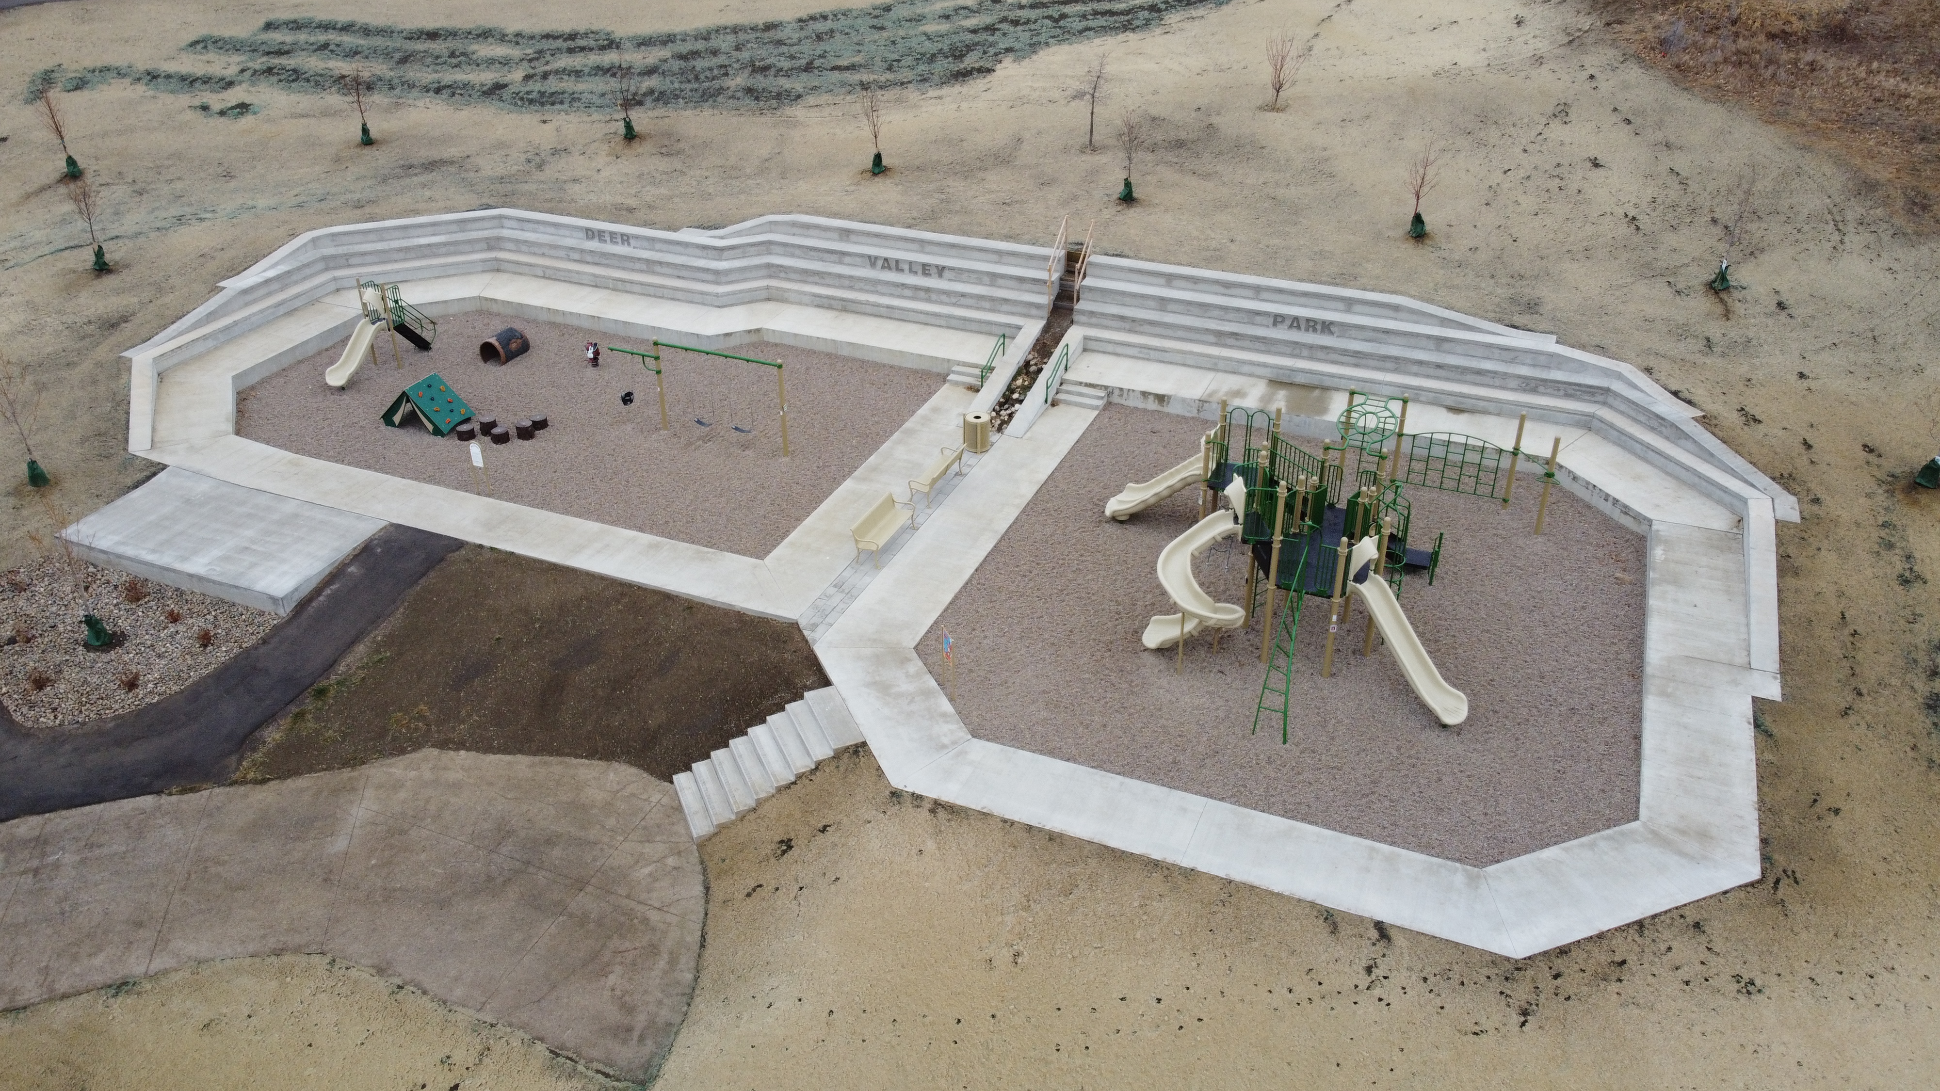
2020 Park Construction
Added 3 tiers of concrete retaining wall
Added steps with handrail
Added picnic table concrete pad
Planted 7 trees in the boulevard
Installed topsoil and seeded boulevards
Planted 12 trees and 8 shrubs in the park
Reshaped the park, installed topsoil and seed
Additions since last AGM

Slide 6
Remaining for Spring 2021
Complete paving stone strip between play structures
Install large climbing rocks in sloped area by driveway
Install large vertical rock with park name & donor plaque
Install 2 picnic tables & bike rack
Establish grass on all newly seeded areas & maintain trees
Fill cracks in paved pathway

Slide 7
Future Possibilities
On our radar…
Survey Results…
(Listed in order of ranking by the community)
Hillside shaping and seeding south of the play structures
Path connecting to the TransCanada Trail
Shaded seating area
Senior kids play court
More trees, shrubs and grassed areas
Fitness & Wellness stations
DONE (by spring 2021)
Picnic area and plaque for donors
FUTURE
Gazebo across the road
Basketball court across the road
Connecting to the Trail
Mountain bike track

Slide 8
Deer Valley Park Survey Results (2019/20)

Slide 9
Thank-you for your support! (it was only 3.5 years ago that the park committee started)
A few parting thoughts…
A HUGE and sincere thanks to Ron & Rosalee for taking care of the park grounds this past summer.
If you have ideas or want to get involved in future park opportunities, please let the DV Board know and they’ll send your info to the committee.
Please respect the work being done in the new year by sharing any ‘closures’ or ‘areas to avoid’ with your children.
The feedback on the park has been overwhelmingly positive – both from Deer Valley residence and from Regina visitors.
Thanks for coming together and helping us bring this park to life.

Slide 10
Community Re-zoning
Re-zone Deer Valley in order to put bylaws in place enforcing the architectural controls that Deer Valley Developments issued when development of Deer Valley began.
Presentation by Luke Grazier, (former) Community Planner for the RM of Lumsden

Slide 11
Financials 2019 (Budget vs Actual - Operating)
Operating Budget | Budget | Actuals
Revenues
Existing Hamlet Allotment Balance 2018 | $ 375,008.81 | $ 409,189.52
Expected Tax Allotment 2018 (40% including Golf Course) | $ 166,991.50 | $ 180,481.12
Deposit Interest | $ -
Revenue Sharing | $ 28,019.00 | $ 26,924.00
Grants | $ -
Total Revenue (Operating Budget) | $ 570,019.31 | $ 616,594.64
Expenses
Curtis Construction | $ 76,000.00 | $ 49,401.10
Summer Maintenance |  | $ 18,476.57
Crack Sealing ** | $ 7,500.00
Loraas Disposal | $ 13,500.00 | $ 14,863.15
Park/Community Space/Community Clean Up Reserve | $ 250,000.00 | $ -
Pest Control** | $ 10,000.00
Recreation | $ 25,000.00 | $ 5,935.17
SaskPower | $ 4,000.00 | $ 3,321.90
Annual General Meeting | $ 500.00 | $ 8,850.61
Website - annual maintenance | $ 2,000.00
Board remuneration | $ 10,000.00
Budget Expenses | $ 398,500.00 | $ 100,848.50
Outstanding Invoices | $ - | $ -
Total Expenses | $ 398,500.00 | $ 100,848.50
Hamlot Allotment Balance | $ 171,519.31 | $ 515,746.14
** Included in the Summer Maintenance Total ($18,476.57)

Slide 12
Financials 2019 (Actuals - Capital)
Capital Infrastructure Reserve
Estimated Reserve Balance 2018 | $ 174,852.59 | $ 238,309.57
Projected Reserve Deposit 2019 (30%) | $ 125,243.63 | $ 135,360.84
Balance available | $ 300,096.22 | $ 373,670.41
Sewer & Water Reserve | $ 150,000.00 | $ -
Road Repairs | $ 150,000.00 | $ -
Other Expenses |  | $ 5,181.90
Estimated Budget Expenses | $ 300,000.00 | $ 5,181.90
Capital Reserve Balance | $ 96.22 | $ 368,488.51

Slide 13
Financials 2020 (Budget - Operating)
Operating Budget | 2020 Budget | 2021 Budget | 2022 Budget | 2023 Budget | 2024 Budget
Revenues
Existing Hamlet Allotment Balance | $ 515,746.14 | $ 2,836.88 | $ 98,872.56 | $ 100,728.01 | $ 102,658.57
Expected Tax Allotment (40% including Golf Course) | $ 184,090.74 | $ 187,772.56 | $ 191,528.01 | $ 195,358.57 | $ 199,265.74
Revenue Sharing | $ 27,000.00 | $ 27,000.00 | $ 27,000.00 | $ 27,000.00 | $ 27,000.00
Grants
Transfer from Reserve | $ 30,000.00
Total Revenue (Operating Budget) | $ 756,836.88 | $ 217,609.44 | $ 317,400.57 | $ 323,086.58 | $ 328,924.31
Expenses
Lighting | $ 4,000.00 | $ 4,100.00 | $ 4,200.00 | $ 4,300.00 | $ 4,400.00
Garbage Removal | $ 15,000.00 | $ 15,300.00 | $ 15,600.00 | $ 15,900.00 | $ 16,200.00
Summer Maintenance (weed control, pest control, grass cutting, street sweeping, landscaping) | $ 15,000.00 | $ 15,000.00 | $ 15,000.00 | $ 15,000.00 | $ 15,000.00
Snow Removal | $ 60,000.00 | $ 61,500.00 | $ 63,000.00 | $ 64,500.00 | $ 66,000.00
Administration (website maintenance, legal fees, AGM, board renumeration) | $ 10,000.00 | $ 10,000.00 | $ 10,000.00 | $ 10,000.00 | $ 10,000.00
Consulting (Asset Report, Feasibility Study etc.) | $ 25,000.00
Community Activities | $ 10,000.00 | $ 10,000.00 | $ 10,000.00 | $ 10,000.00 | $ 10,000.00
Road Maintenance | $ 615,000.00
Transfer to Reserve at beginning of year |  | $ 2,836.88 | $ 98,872.56 | $ 100,728.01 | $ 102,658.57
Total Expenses | $ 754,000.00 | $ 118,736.88 | $ 216,672.56 | $ 220,428.01 | $ 224,258.57
Estimated Hamlet Allotment Balance | $ 2,836.88 | $ 98,872.56 | $ 100,728.01 | $ 102,658.57 | $ 104,665.74

Slide 14
Financials 2020 (Budget - Capital)
Capital Reserve | 2020 Budget | 2021 Budget | 2022 Budget | 2023 Budget | 2024 Budget
Estimated Reserve Balance | $ 368,488.51 | $ 41,906.57 | $ 185,572.87 | $ 428,091.43 | $ 675,338.37
Projected Reserve Deposit (30%) | $ 138,068.06 | $ 140,829.42 | $ 143,646.01 | $ 146,518.93 | $ 149,449.30
Transfer from Operating Account |  | $ 2,836.88 | $ 98,872.56 | $ 100,728.01 | $ 102,658.57
Balance available | $ 506,556.57 | $ 185,572.87 | $ 428,091.43 | $ 675,338.37 | $ 927,446.24
Sewer & Water Major Expenditure | $ 150,000.00
Road Major Expenditure | $ 150,000.00
Park Major Expenditure | $ 134,650.00
Major Expenses
Transfer to Operating | $ 30,000.00
Estimated Budget Expenses | $ 464,650.00 | $ - | $ - | $ - | $ -
Estimated Infrastructure Reserve Balance | $ 41,906.57 | $ 185,572.87 | $ 428,091.43 | $ 675,338.37 | $ 927,446.24

Slide 15
2021 Anticipated Activities
Complete landscaping of park area
Social activities (pandemic permitting)
Continued community beautification – boulevards, etc.
Public Utility – feasibility assessments of different options

Slide 16
Board Member Election
Board Member Election (replacing Dave Frey)
4 year term (end of term replacement)

Slide 17
Utility Board Election
Utility Board Election (3-6 positions)
3 year term (end of term replacement)

Slide 18
Open Forum
Topics from community
Recycling Pickup (Loraas)

Slide 19
Adjourn
Thank-you everyone for attending!
Distribution List – board@deervalleysask.ca

